Slide 1
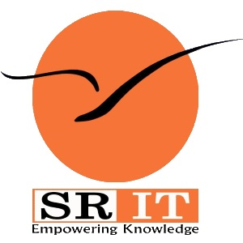
Enhancing DevOps Security with AI and Machine Learning
by
C Yamini
Roll No. 214G1A33C5
P Uday Chowdary
Roll No. 214G1A33B5
S Sahil
Roll No. 224G5A3309
K Vignutha Reddy
Roll No. 214G1A32C3
Under the guidance of
Dr. C Sasikala _{M. Tech, Ph.D}
Associate Professor
Department of Computer Science and Engineering (AI & ML)
Srinivasa Ramanujan Institute of Technology
(Affiliated to JNTUA & Approved by AICTE) (Accredited by NAAC with ‘A’ Grade & Accredited by NBA (EEE, ECE & CSE)
Rotarypuram Village, B K Samudram Mandal, Ananthapuramu – 515701.
2024 - 2025

Slide 2

Contents
Abstract
Introduction
Literature survey
Proposed Work
References
GitHub Link
Queries

Slide 3
Abstract :-
In modern software development and operations, DevOps (a combination of development and operations) has become a key methodology to accelerate delivery, improve quality, and enhance security. Meanwhile, artificial intelligence (AI) and machine learning (ML) are also playing an increasingly important role in cybersecurity, helping to identify and respond to increasingly complex threats. In this article, we'll explore how AI and ML can be integrated into DevOps practices to ensure the security of software development and operations processes. We'll cover best practices, including how to use AI and ML for security-critical tasks such as threat detection, vulnerability management, and authentication. In addition, we will provide several case studies that show how these technologies have been successfully applied in real projects and how they have improved security, reduced risk, and accelerated delivery. Finally, through this article, readers will learn how to fully leverage AI and ML in the DevOps process to improve software security, reduce potential risks, and provide more reliable solutions for modern software development and operations.
Keywords: Data security; DevOps; Machine Learning; Artificial Intelligence.

Slide 4
Introduction
Synergy of DevOps and AI/ML: DevOps focuses on automation and process improvement, while AI/ML enhances automation for testing, monitoring, and troubleshooting, improving delivery speed, quality, and decision-making.
DevOps Fundamentals: DevOps integrates development, operations, and quality assurance to shorten software development cycles, enabling faster iteration and collaboration through an automated, shared platform.
Shift-Left Approach: DevOps promotes shared responsibility for quality by shifting testing and operations considerations earlier in the development cycle, improving productivity and responsiveness to business needs.
Importance of Security in DevOps: Fast delivery in DevOps can introduce security vulnerabilities, leading to risks like data breaches and reputational damage, necessitating integrated security measures.
AI/ML Enhancing DevOps Automation: AI/ML tools automate processes such as code reviews, code analysis, unit testing, and troubleshooting, reducing manual intervention and improving efficiency.
Automated Code Review: AI/ML tools analyze code to detect defects, enforce standards, and distribute review workloads, leading to earlier detection of issues and improved code quality.
Intelligent Code Analysis: AI-powered tools analyze large code repositories to identify performance issues, resource leaks, and race conditions while recommending improvements.

Slide 5
Cont…
DevOps Security Challenges: Security automation tools are limited, as certain vulnerabilities (e.g., access control or business logic issues) still require manual oversight, emphasizing the need for human expertise.
Real-World Case Study - CircleCI: A security incident at CircleCI underscored the importance of quick responses, transparency, and user education in limiting risks and rebuilding trust.
Continuous Improvement: Following security incidents, DevOps providers and teams must continuously enhance security measures to prevent future vulnerabilities.
DevOps Challenges: Enterprises face issues such as a skills shortage, unclear transformation goals, inadequate automation, and technical complexities like microservices and toolchain integration.
DevOps Skills Gap: A lack of domain experts with both technical and soft skills hinders DevOps adoption, especially in complex environments with evolving technologies.
Cultural and Organizational Impact: Successful DevOps adoption requires prioritizing cultural and organizational changes, not just focusing on metrics like efficiency and delivery speed.
Balancing Security and Efficiency: Integrating AI/ML into DevOps enables continuous monitoring, threat detection, and compliance, reducing long-term costs and improving software reliability and security.

Slide 6
LiteratureSurvey
No | Title | Author | Journal Name & Year | Methodology Adapted | Key Findings | Gaps
1. | Intelligent Advertising Recommendation and Abnormal Advertising Monitoring System in the Field of Machine Learning | Grace M C , Zhou W , Jiang X , et al | International Journal of Computer Science and Information Technology, vol 1. | Machine Learning Techniques | Intelligent advertising recommendation, Click rate prediction, Abnormal advertising monitoring, Machine learning | Exploring Abnormal Detection Precision
2 | “Research on Machine Learning With Algorithms and Development | Yu, Liqiang, et al | Theory and Practice of Engineering Science, vol. 3 | Machine Learning Techniques | Machine Learning, Algorithm, Development | Limited Analysis of Real-World Applications

Slide 7
Proposed System
AI/ML-Driven Automation in DevOps :-AI/ML enhances DevOps processes by automating code reviews, testing, threat detection, and performance monitoring, ensuring faster delivery and higher-quality software.
Critical Role of Security in DevOps :-Security must be integrated into DevOps to mitigate risks like data breaches and ensure compliance with regulations, balancing speed with safety.
Self-Healing Systems :-AI/ML enables self-healing tests and systems that adapt to changes, improving system reliability and reducing manual intervention.
Real-Time Threat Detection and Monitoring :-AI-powered tools identify anomalies, monitor systems continuously, and alert teams to potential vulnerabilities, strengthening security frameworks.
Future of AI/ML in DevOps Security :-AI/ML adoption will continue to grow, addressing challenges like skill shortages, and fostering a collaborative culture focused on innovation and security.
Predictive Analytics for Resource Optimization :-AI/ML leverages predictive analytics to optimize resource allocation, reduce downtime, and forecast system requirements, enhancing overall efficiency in DevOps workflows.

Slide 8
References
[1] “Applying DevOps Practices of Continuous Automation for Machine Learning” byIoannis Karamitsos 1, Saeed Albarhami 1 and Charalampos Apostolopoulos – 2020.
[2] “AI-Powered DevOps and MLOps Frameworks: Enhancing Collaboration, Automation, and Scalability in Machine Learning Pipelines” By Sumanth Tatineni, DevOps Engineer at Idexcel Inc, USA Venkat Raviteja Boppana, Sr Consultant, Solution at Avanade, US - 2021.
[3] “AI-Powered Continuous Deployment: Leveraging Machine Learning for Predictive Monitoring and Anomaly Detection in DevOps Environments” by Venkata Mohit Tamanampudi, DevOps Automation Engineer, JPMorgan Chase, Wilmington, US – 2022.
[4] “AI-driven DevOps: Leveraging machine learning for automated software deployment and maintenance” by Oyekunle Claudius Oyeniran1, Adebunmi Okechukwu Adewusi, Adams Gbolahan Adeleke, Lucy Anthony Akwawa4, & Chidimma Francisca Azubuko - 2023.

Slide 9
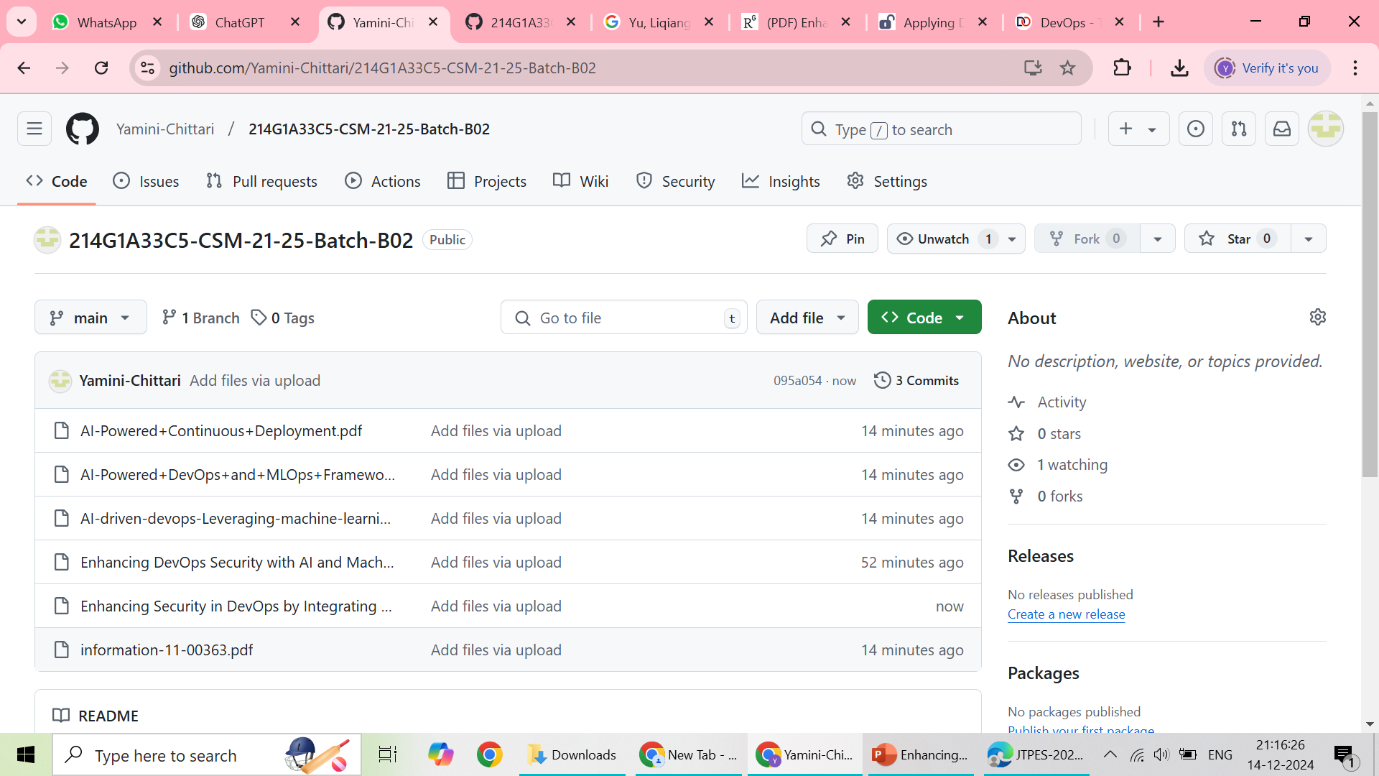

Git Hub Dashboards of each student

Slide 10
Any Queries?

Slide 11
Thank You!!!

